Slide 1

LAB 3 SOFTWARE DESIGN AND ARCHITECTURE
NATIONAL UNIVERSITY OF MODERN LANGUAGES Faculty of Engineering and Computing Department of Software Engineering
Course Instructor: | Mr. Ahsan Arif
 | Lecturer Department of Software Engineering, NUML Islamabad

Slide 2
Use Case Description

Slide 3
Contents
Use Case Identification
1.1. Use Case ID
1.2. Use Case Name
1.3. Use Case History 1.3.1 Created By
1.3.2 Date Created 1.3.3 Last Updated By 1.3.4 Date Last Updated
2. Use Case Definition
3. Use Case Templates

Slide 4
How to describe Use Cases?
Use Case Specification is known as Use Case Description.
The Use Case Specification includes:
1. Use Case Identification:
Use case ID:
A unique identifier that is helpful for tracking the use case record.
Use Case Name:
State a concise, results-oriented name for the use case. These reflect the tasks the user needs to be able to accomplish using the system.
Use Case History:
Created By : Supply the name of the person who initially documented this use case.
Date Created: Enter the date on which the use case was initially documented.
Last Updated By: Supply the name of the person who performed the most recent update to the use case description.
Date Last Updated: Enter the date on which the use case was most recently updated.

Slide 5
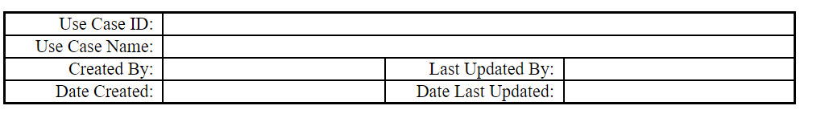
How to describe Use Cases?

Slide 6
How to describe Use Cases?
Actors:
Actors are the people or the systems who interact with the use cases. In other words, we can say that actors perform the functional requirements. For example, the title “Register Employee” is the functional requirement representing the use case and it can be performed by an actor.
Brief description:
A brief textual description of what the use case does or Summary of the Use Case.
Describe the Use Case not more than 5 lines.
Preconditions:
Preconditions are the requirements that must fulfill before the activity.
Postconditions:
Postconditions represents the finish of the use case successfully or unsuccessfully. Its can be further extended to the main success scenario and alternate scenario.
Path:
The path is the step-by-step action that places between the actor and the system. Paths come in three types:

Slide 7
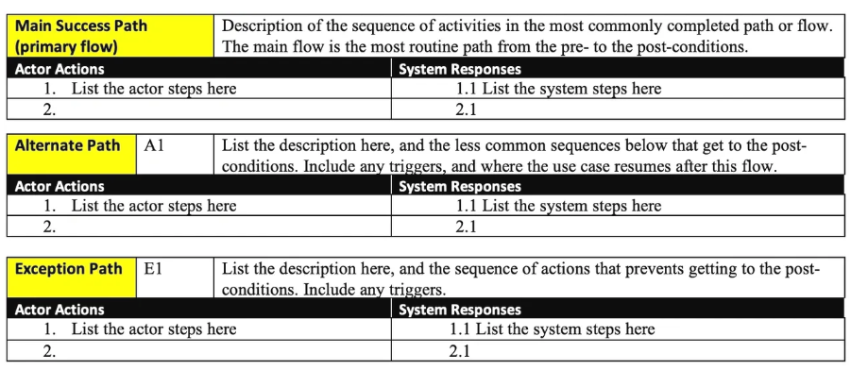
How to describe Use Cases?

Slide 8
How to describe Use Cases?
Basic Flow | is the normal flow of action in an application. For example, in the login page after entering user name and password the next screen should appear is the basic flow.
Alternative Flow | are the alternative actions that can be performed. For example, in the login page the alternative flow will be checking the existence of the user name entered.
Exception | are the activities in case of the exception thrown. They are the flow of events which will happen in case of the error.

Slide 9
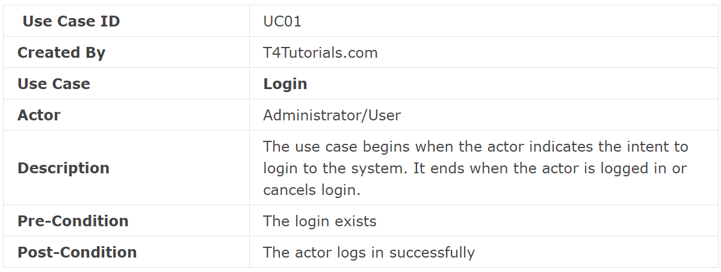
Examples…

Slide 10
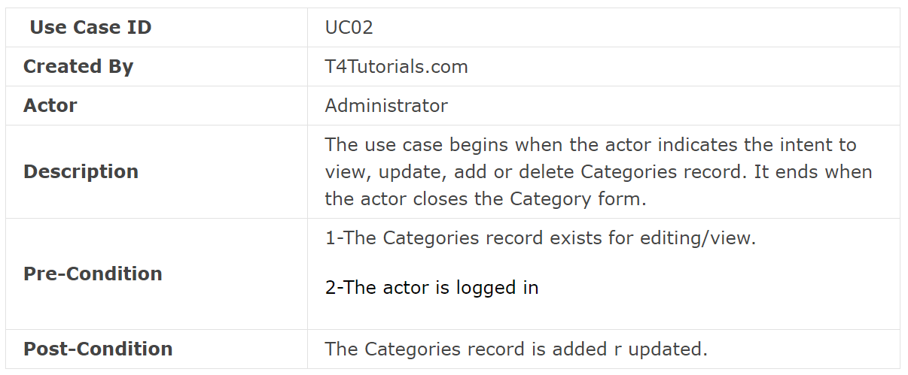
Examples…

Slide 11
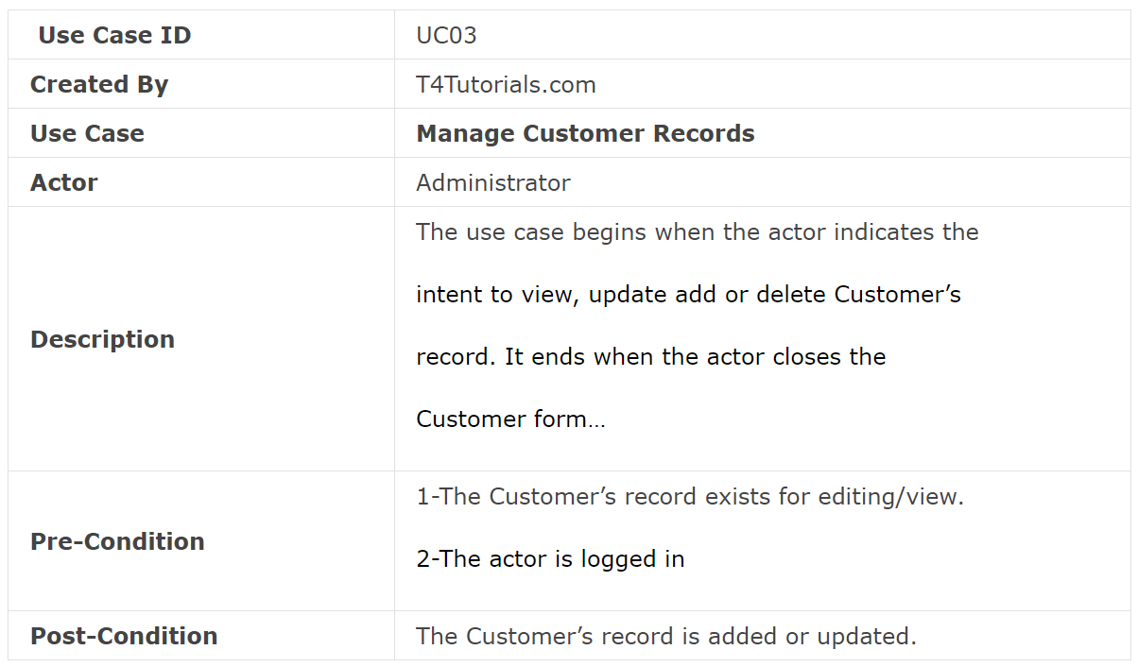
Examples…

Slide 12
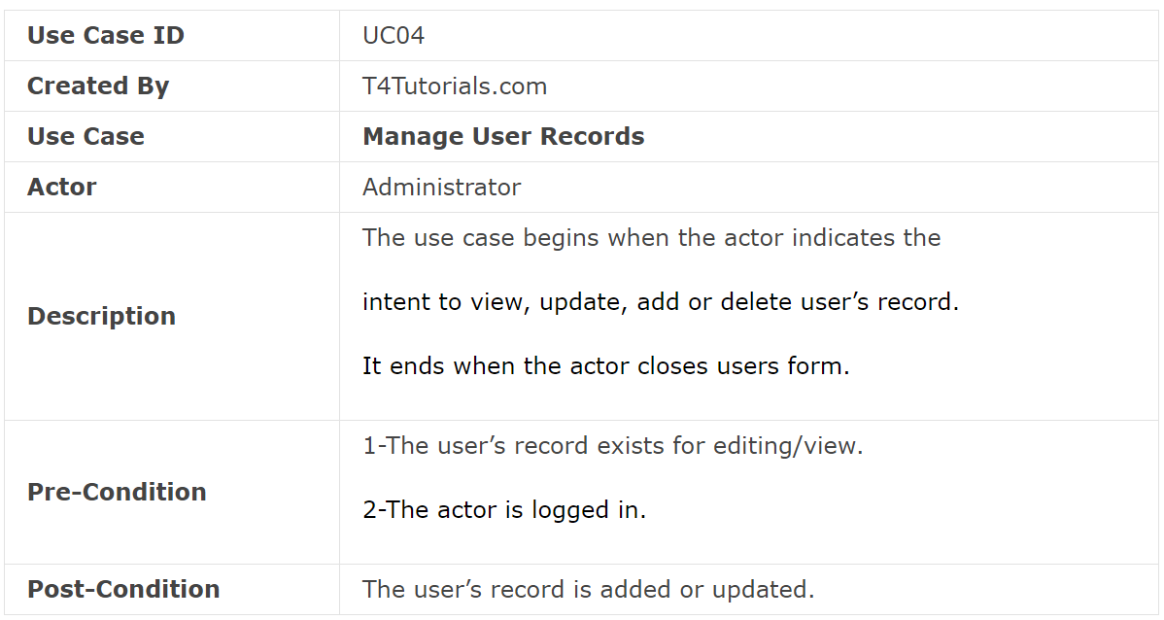
Examples…

Slide 13
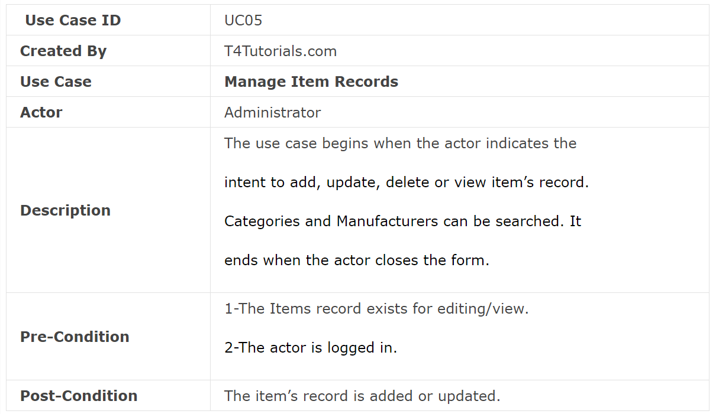
Examples…

Slide 14
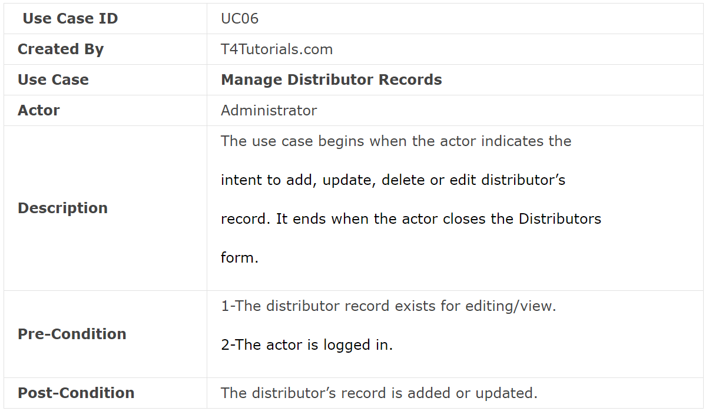
Examples…

Slide 15
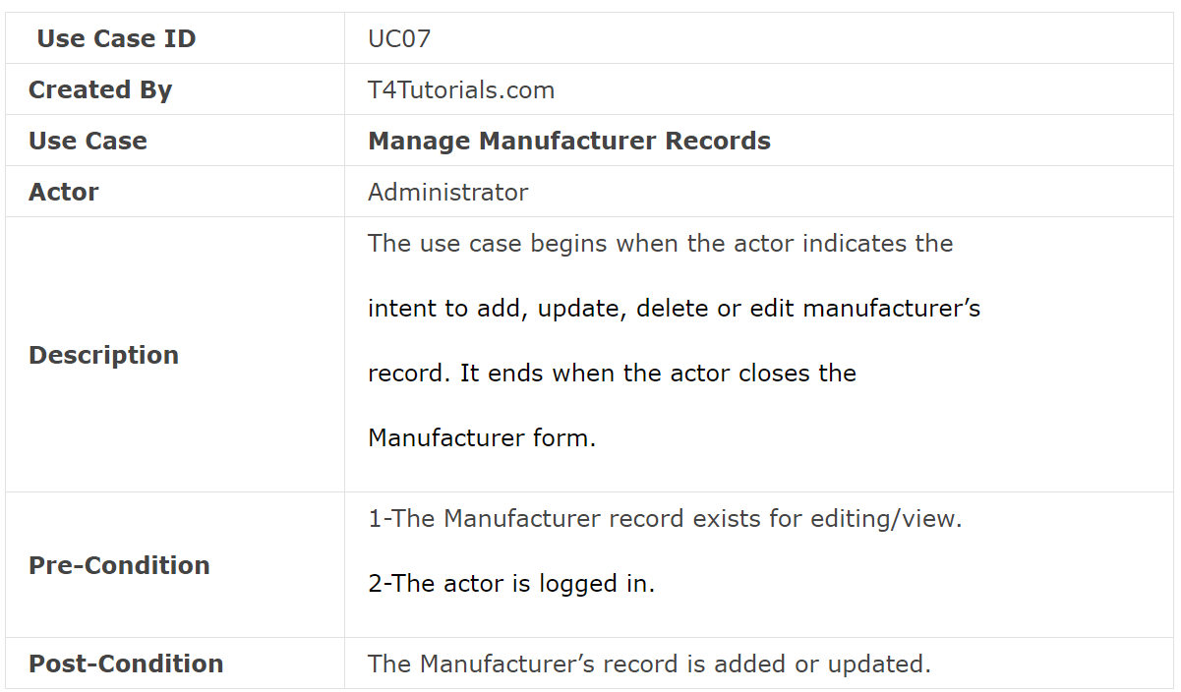
Examples…

Slide 16
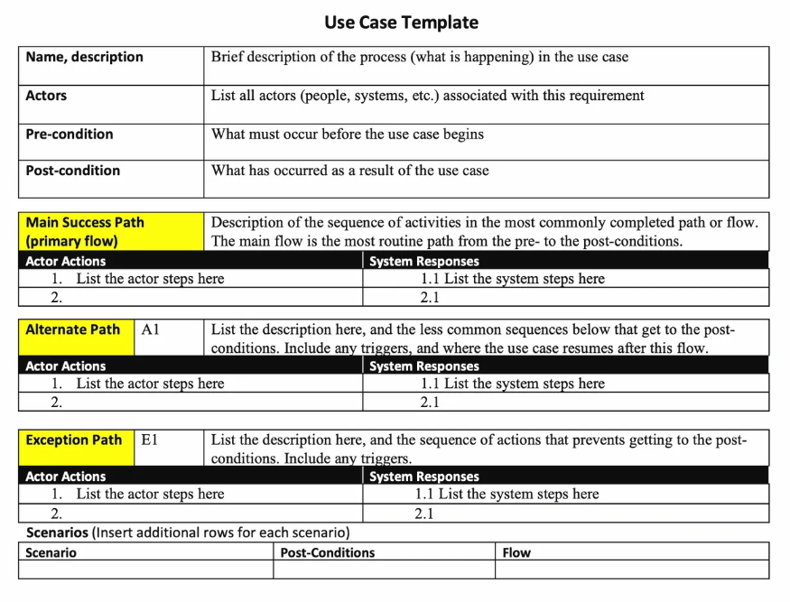
Use Case Template
Notes:
Trigger - An event that initiates the flow of events in a use case. Triggers can either be an actor action or a temporal event.
Actor Actions - The most common trigger when an action taken by the primary actor (input) initiates the use case.
Temporal Event – Time-related events that may trigger a use case. Commonly used when actions need to be executed during a specific time of day or on a specific date.

Slide 17
Reference:
https://www.ecs.csun.edu/~rlingard/COMP682/use_case_template.htm

Slide 18
Thank You...
Mr. Ahsan Arif
Lecturer (Dept. of Software Engineering)
ahsanarif.se42@gmail.com

